Slide 1
Process Scheduling Module 4
Operating Systems
Nadia Qureshi

Slide 2
Round Robin Scheduling
The Round-Robin (RR) scheduling is designed especially for time sharing systems
In this algorithm there is small unit of time known as time quantum
A time quantum is generally up to 10-100ms
CPU scheduler goes around the ready queue, allocating the CPU to each process for a time interval of up to 1 quantum

Slide 3
Round Robin Scheduling
For RR scheduling we keep the ready queue as a FIFO queue of processes
The CPU picks up the first process from the ready queue, set a timer to interrupt after 1 quantum
If the process burst time is less than 1 quantum
then the process itself release the CPU voluntarily & proceed to next process
If the process burst time is greater then 1 quantum
then that process is sent back to the ready queue and CPU scheduler selects the next process in the ready queue for scheduling

Slide 5
Round Robin Scheduling
Process Burst Time
P₁ 53
P₂ 17
P₃ 68
P₄ 24
Time quantum = 20 ms
The Gantt chart is:
Typically, higher average turnaround than SJF, but better response
P₁
P₂
P₃
P₄
P₁
P₃
P₄
P₁
P₃
P₃
0
20
37
57
77
97
117
121
134
154
162

Slide 6
Practice Problem – Round Robin with Time Quantum = 2ms
Processes | Arrival Time | Burst Time
P1 | 0 | 5
P2 | 1 | 4
P3 | 2 | 2
P4 | 4 | 1

Slide 7
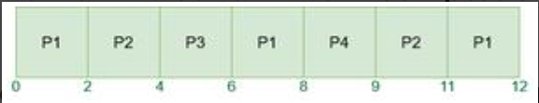
Practice Problem – Round Robin with Time Quantum = 2ms
Processes | Arrival Time | Burst Time
P1 | 0 | 5
P2 | 1 | 4
P3 | 2 | 2
P4 | 4 | 1

Slide 8
Priority Scheduling
In priority scheduling a priority is associated with each process and the CPU is allocated to the process with the highest priority
Equal priority processes are scheduled in FCFS order
Priorities are generally some fixed range of numbers, such as 0, 1, 5, 10
There is no general agreement on whether ‘0’ is highest or lower priority
Priority can be defined on the bases of following
Process time limit
Memory requirements
Number of open files
Ratio of average I/O burst to CPU burst

Slide 9
Priority Scheduling - Salient points
Priority mechanism can be static or dynamic
Static priority mechanism is easy to implement and have relatively low overheads
Dynamic priority mechanism is more complex to implement and have greater overheads
The priority scheduling may be preemptive or non-preemptive
The choice arise when a high priority process comes in the queue while a low priority process is executing
A process that is ready to run but lacking the CPU can be considered blocked
Solution to indefinite blocking is aging
Aging is a technique of gradually increasing the priority of processes that waits for a long time
OS allows only a limited priority classes
In VAX / VMS priority range is 0 to 31
In Unix priority range is -20 to 20
Notes:
VAX (virtual address eXtension) refers to a family of minicomputers developed by DEC. The VAX architecture introduced 32-bit virtual addressing, which allowed for more efficient memory management and greater computational power. It supported a complex instruction set (CISC), which was flexible and powerful for scientific, business, and engineering applications. VAX systems were widely used in universities, research institutions, and businesses during the 1980s and 1990s due to their performance and flexibility.
VMS
VMS (Virtual Memory System) was the operating system designed for VAX systems. VMS is known for its advanced features, such as virtual memory management, robust process scheduling, and a high degree of system reliability and security. The priority range in VMS, from 0 to 31, reflects the priorities of tasks in the operating system. Higher numbers indicate higher priorities, meaning tasks with a priority of 31 have the most CPU scheduling preference. VMS eventually evolved into OpenVMS, which extended support for newer hardware like the Alpha and Itanium processors.

Slide 10
Multilevel Queue
Ready queue is partitioned into separate queues: foreground (interactive) background (batch)
Each queue has its own scheduling algorithm
foreground – RR
background – FCFS
Scheduling must be done between the queues
Fixed priority scheduling; (i.e., serve all from foreground then from background)
Possibility of starvation
Time slice – each queue gets a certain amount of CPU time which it can schedule amongst its processes; i.e., 80% to foreground in RR
20% to background in FCFS

Slide 11
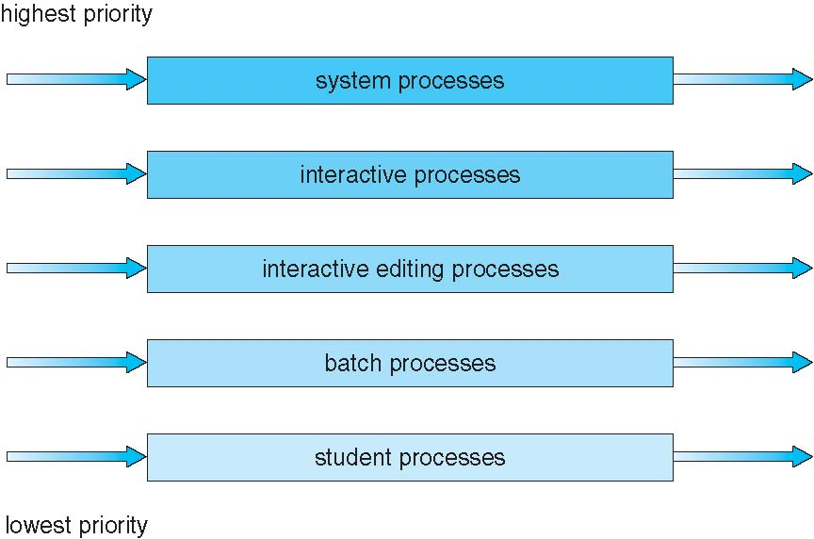
Multilevel Queue Scheduling

Slide 12
Multilevel Queue Scheduling
System Processes: High-priority processes that the OS needs to manage.
Interactive Processes: Processes that require user interaction and need quicker response times.
Interactive Editing Processes: Lightweight, user-oriented processes that need frequent CPU access.
Batch Processes: Background processes that don't require immediate CPU access, such as printing or data processing tasks.

Slide 13
Multilevel Queue Scheduling
Each of these queues has its own scheduling algorithm. For instance:
The system processes queue might use a First-Come, First-Served (FCFS) algorithm for simplicity and efficiency.
The interactive processes queue might use Round Robin to allow fair sharing of CPU time among interactive tasks.
The batch processes queue might use Shortest Job Next (SJN) or First-Come, First-Served (FCFS), as these processes don't need immediate response.

Slide 14
Multilevel Feedback Queue
How Multi-Level Feedback Queue Works
Initial Queue Placement:
When a process enters the system, it is placed in the highest-priority queue.
Time Quantum:
Each queue can have a time quantum (a specific amount of CPU time) associated with it. Higher-priority queues typically have shorter time quanta to favor short, interactive tasks.
Process Demotion:
If a process exhausts its time quantum in a high-priority queue without completing, it is moved (demoted) to the next lower-priority queue. This demotion continues until the process either completes or reaches the lowest-priority queue.
The lowest-priority queue often uses FCFS scheduling with a longer time quantum, accommodating CPU-bound processes that can run without frequent preemption.
Process Promotion:
I/O-bound or interactive processes that frequently release the CPU before using up their time quantum may stay in or even move up to higher-priority queues.
This promotion helps these short, frequent jobs get CPU time quickly and remain responsive.
Aging Mechanism:
Long-waiting processes in lower-priority queues are gradually promoted to prevent starvation.
For example, a process in the lowest queue could be promoted if it has been waiting for a certain amount of time, allowing it to move closer to a higher-priority queue and receive CPU time sooner.

Slide 15
Multilevel Feedback Queue
Example
Three queues:
Q₀ – time quantum 8 milliseconds
Q₁ – time quantum 16 milliseconds
Q₂ – FCFS
Scheduling
A new job enters queue Q₀ which is served FCFS
When it gains CPU, job receives 8 milliseconds
If it does not finish in 8 milliseconds, job is moved to queue Q₁
At Q₁ job is again served FCFS and receives 16 additional milliseconds
If it still does not complete, it is preempted and moved to queue Q₂

Slide 16
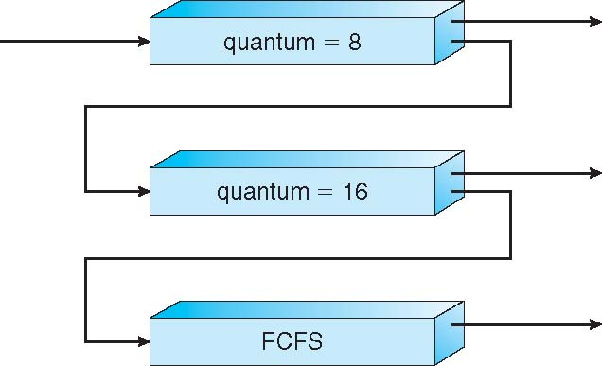
Multilevel Feedback Queues

Slide 17
Multilevel Feedback Queue
A process can move between the various queues
aging can be implemented this way
Multilevel-feedback-queue scheduler defined by the following parameters:
number of queues
scheduling algorithms for each queue
method used to determine when to upgrade a process
method used to determine when to demote a process
method used to determine which queue a process will enter when that process needs service

Slide 18
Multilevel queue scheduling (MLQ) | Multilevel feedback queue scheduling (MLFQ)
It is queue scheduling algorithm in which ready queue is partitioned into several smaller queues and processes are assigned permanently into these queues. The processes are divided on basis of their intrinsic characteristics such as memory size, priority etc. | In this algorithm, ready queue is partitioned into smaller queues on basis of CPU burst characteristics. The processes are not permanently allocated to one queue and are allowed to move between queues.
In this algorithm queue are classified into two groups, first containing background processes and second containing foreground processes. 80% CPU time is given to foreground queue using Round Robin Algorithm and 20% time is given to background processes using First Come First Serve Algorithm. | Here, queues are classified as higher priority queue and lower priority queues. If process takes longer time in execution it is moved to lower priority queue. Thus, this algorithm leaves I/O bound and interactive processes in higher priority queue.
The priority is fixed in this algorithm. When all processes in one queue get executed completely then only processes in other queue are executed. Thus, starvation can occur. | The priority for process is dynamic as process is allowed to move between queue. A process taking longer time in lower priority queue can be shifted to higher priority queue and vice versa. Thus, it prevents starvation.
Since, processes do not move between queues, it has low scheduling overhead and is inflexible. | Since, processes are allowed to move between queues, it has high scheduling overhead and is flexible.

